Slide 1
FAKE NEWS PROJECT

Slide 2
PROBLEM STATEMENT
Fake news has become one of the biggest problems of our age. It has serious impact on our online as well as offline discourse. One can even go as far as saying that, to date, fake news poses a clear and present danger to western democracy and stability of the society.

Slide 3
UNDERSTANDING:
This project is all about the how fake news creates a big-to-big problems in our age. Nowadays fake news spreading like water and people share this wrong information without verifying it. This can impact serious problem on our online as well as offline discourse. One can even go as far as saying that, to date, fake news poses a clear and present danger to western democracy and stability of the society. It has rows and columns for acquiring the data and describing the time period that represents it. There are two datasets one for fake news and one for true news. In fake news, there is 23481 news and in true news, 21417 news.

Slide 4
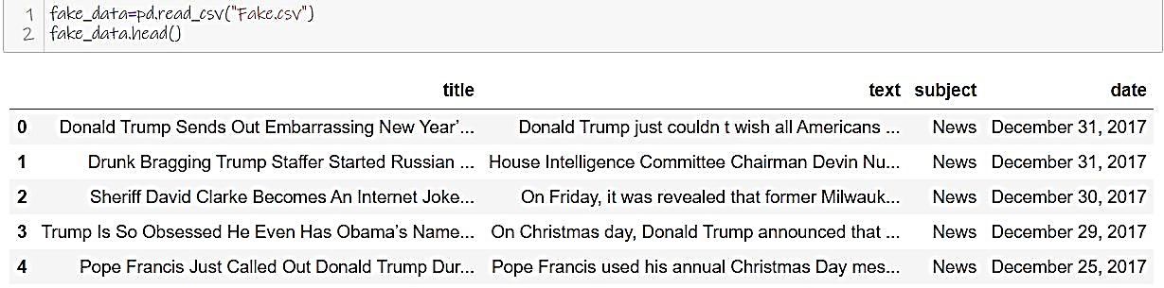
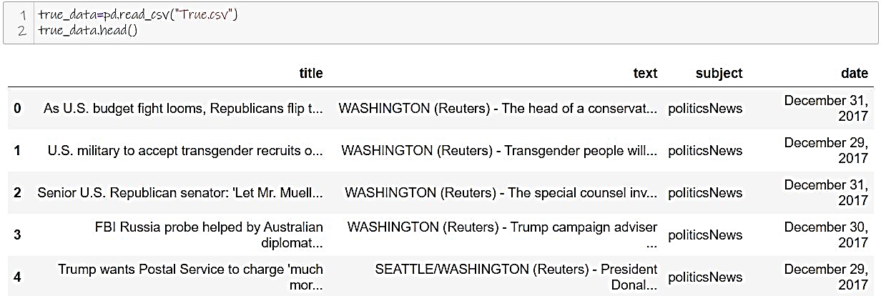
EDA STEPS AND VISUALIZATIONS:
Data Collection

Slide 5
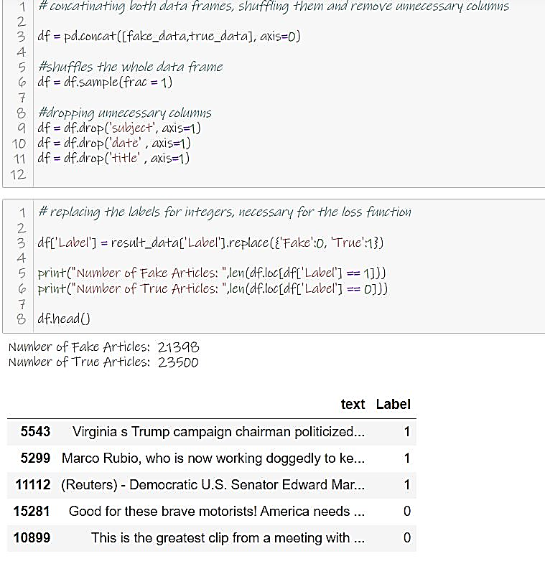
CONCATINATING BOTH DATAFRAMES[by shuffling them and remove unnecessary columns]

Slide 6
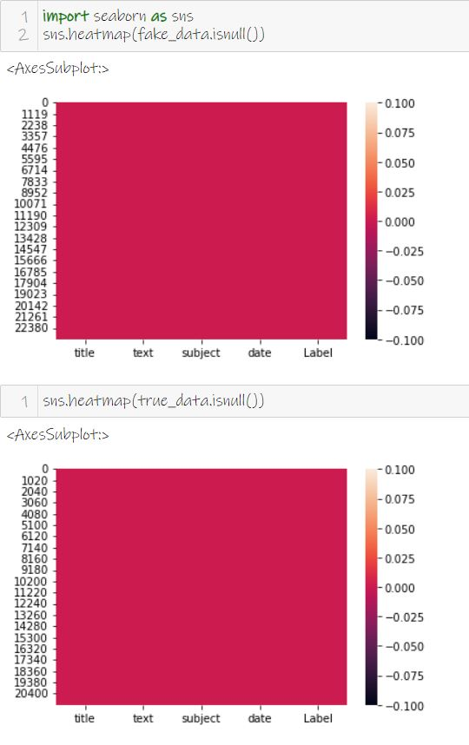
DATASETS:

Slide 7
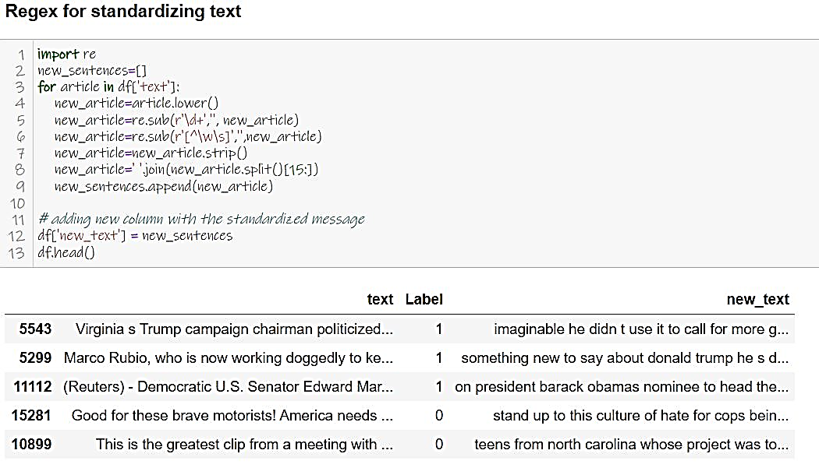
Regex for standardizing text:

Slide 8
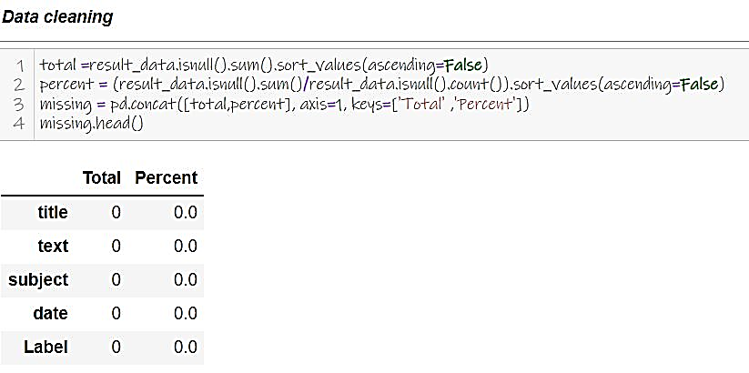
DATA CLEANING

Slide 9
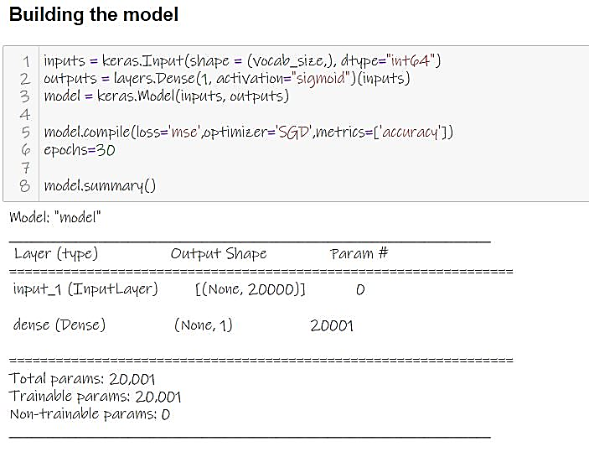
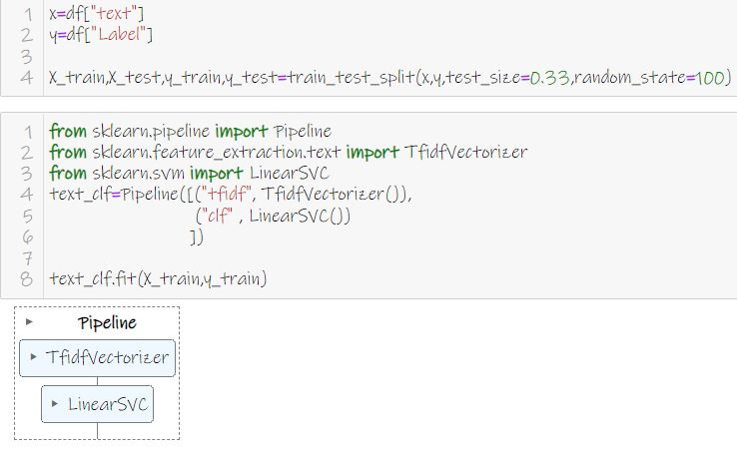
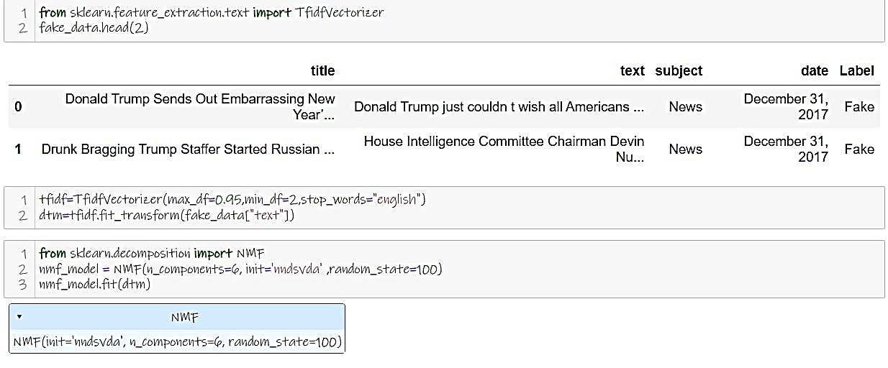
MODEL BUILDING

Slide 10
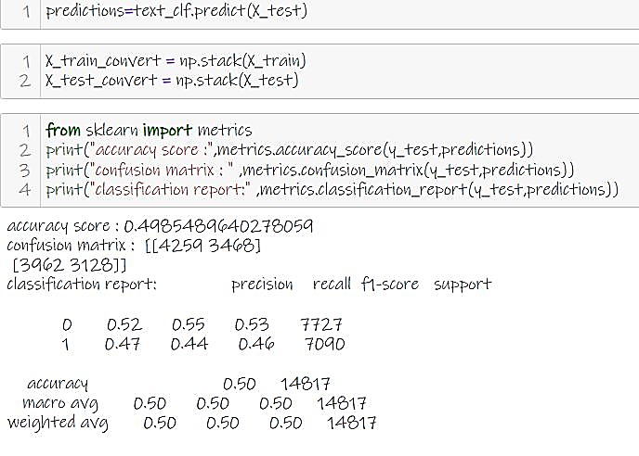
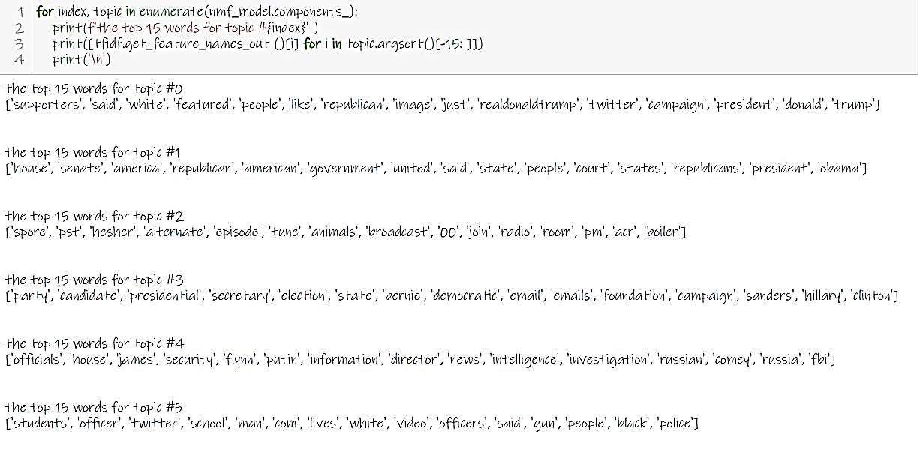
PREDICTION MODEL:

Slide 11
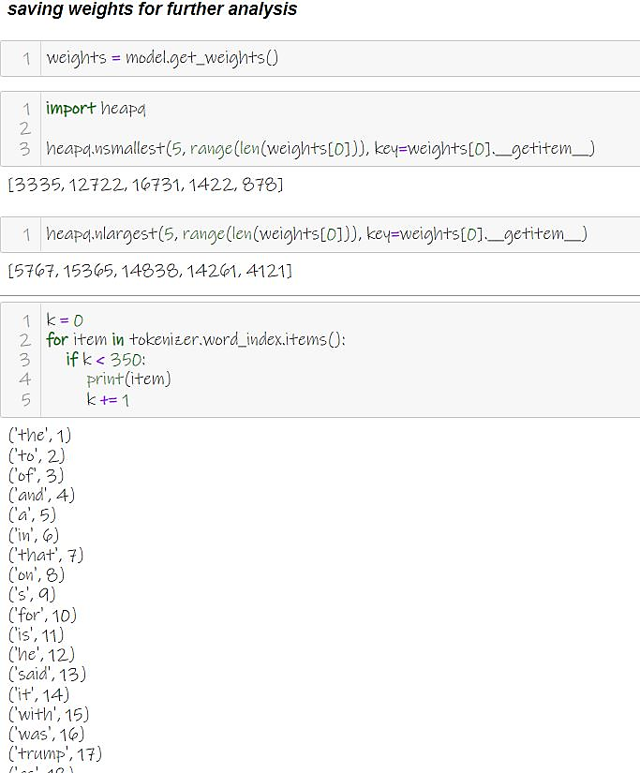
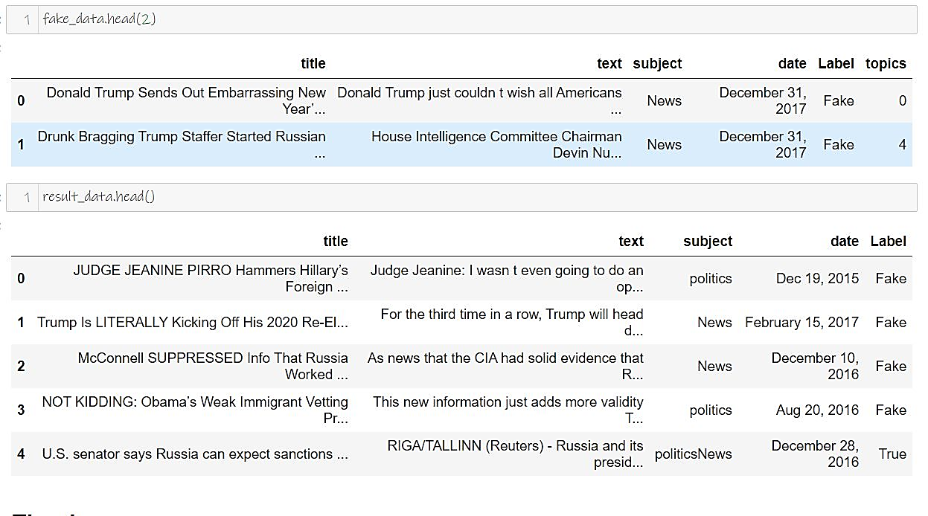
SAVING WEIGHTS FOR FUTHER ANALYSIS:

Slide 12
STEPS AND ASSUMPTIONS TO COMPLETE THE PROJECT:
The results were interpreted from the preprocessing and modelling:
1. The predictions for news related politics, fashion and many more are not always correct.
2. So, it is clearly visible how much the quality and quantity of training data affects this fake news detection model.
3. If the model is trained with a more diverse dataset with news from various different domains, obtaining a much more robust and accurate classifier is not too far-fetched.
4. Aim to provide the user with the ability to classify the news as fake or real and also check the authenticity of the website publishing the news.
5. By using vectorizing data: TF-IDF that computes “relative frequency” that a word appears in a document compared to its frequency across all documents. TF-IDF weight represents the relative importance of a term in the document and entire corpus.
6. Accuracy was noted for all models.
7. Confusion Matrices for Static System.

Slide 13
CONCLUSION
Nowadays, the majority of the tasks are done online. Newspapers that were earlier preferred as hard-copies are now being substituted by applications like Facebook, Twitter, and news articles to be read online. Whatsapp’s forwards are also a major source. The growing problem of fake news only makes things more complicated and tries to change or hamper the opinion and attitude of people towards use of digital technology. When a person is deceived by the real news two possible things happen- People start believing that their perceptions about a particular topic are true as assumed. Thus, in order to curb the phenomenon, have developed input from the user and classify it to be true news or fake news. To implement this, various NLP and Machine Learning Techniques have to be used. The model is trained using an appropriate dataset and performance evaluation is also done using various performance measures. The best model, i.e. the model with highest accuracy is used to classify the news headlines or articles, that it will be classified to its true nature.

Slide 14
THANK YOU

